Slide 1

12:34
12:39
12:49
12:52

Slide 2




Slide 4


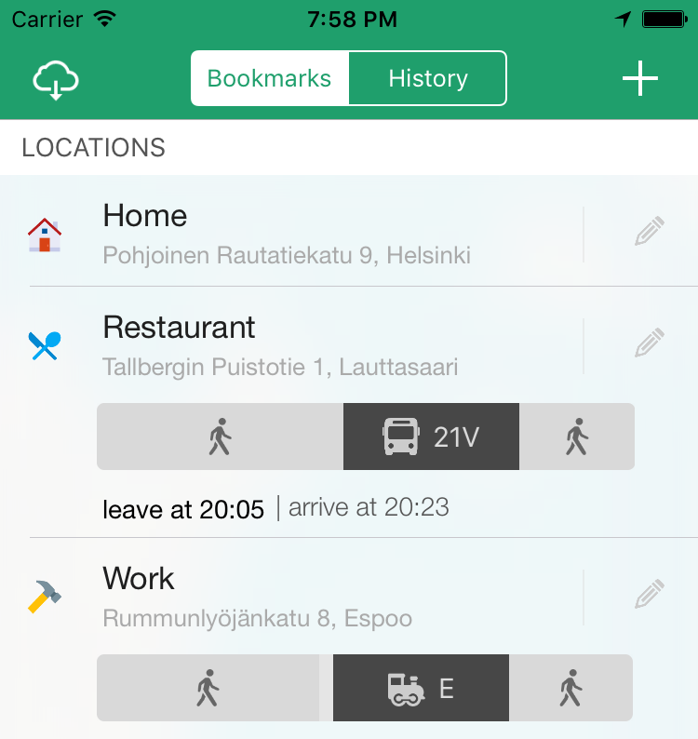

Slide 5



Slide 6








Slide 9


Slide 10
Helsinki 12:30
http://www.fontspace.com/category/thin?p=2
http://www.fontspace.com/nimavisual/trench

Slide 11




Slide 12





Slide 15






Slide 16
M

Slide 17


Slide 18



Slide 19


Slide 20





Slide 21


Slide 26





Slide 27


Slide 28



Slide 41



Slide 42


Slide 43


Slide 44


Slide 47


Slide 48


Slide 49







Slide 50





Slide 51


Ewket Apps
®
Ewket Apps
®

Slide 52










Slide 54




Slide 55


Slide 56



Slide 58

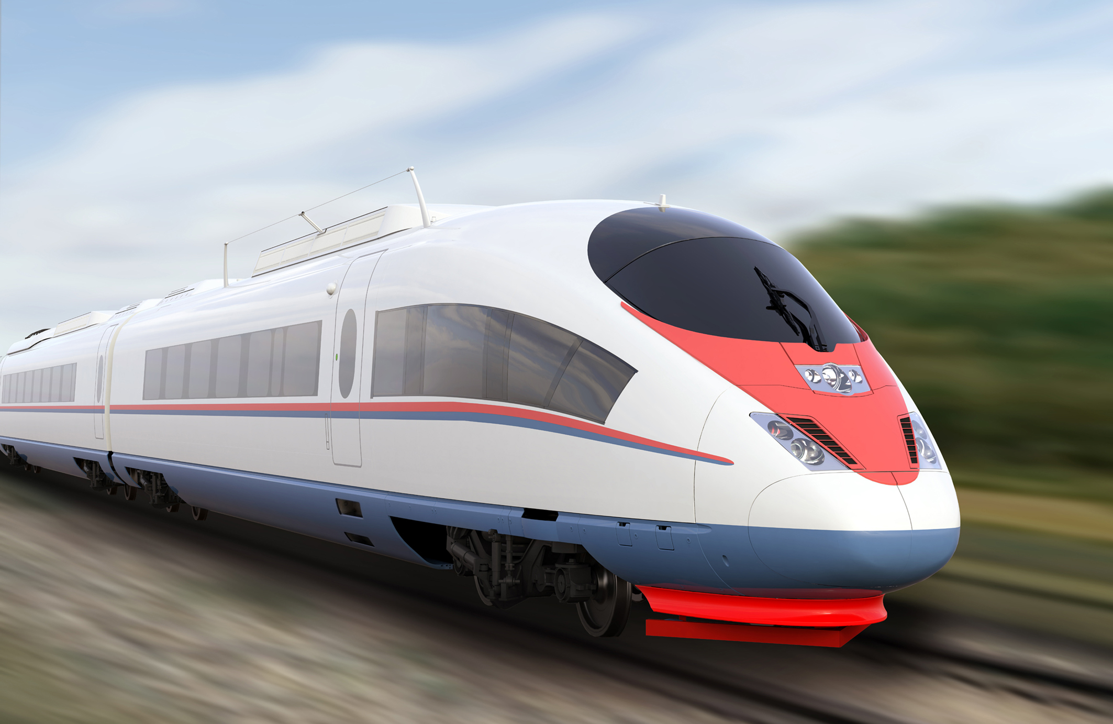

Slide 60
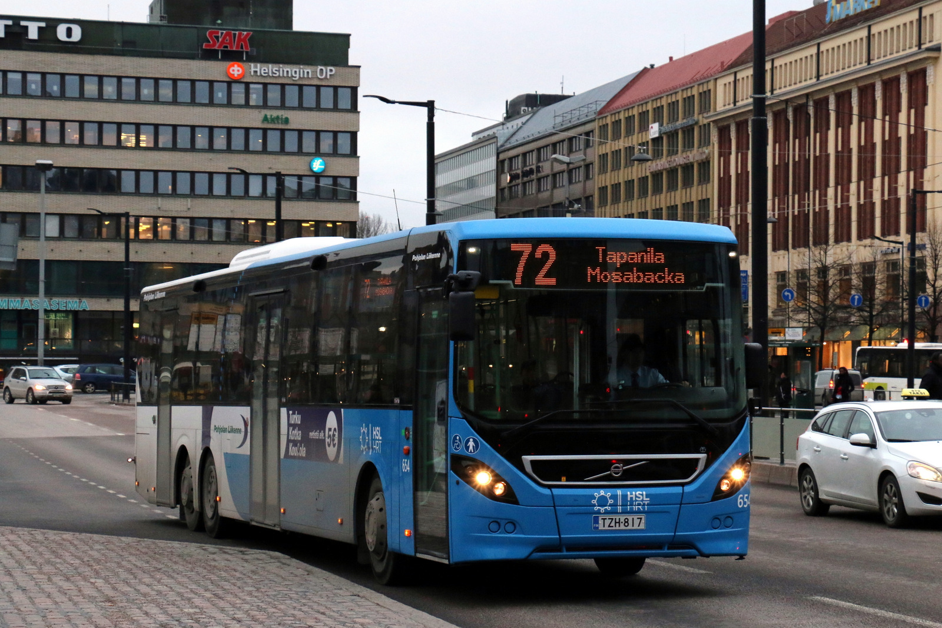

Slide 62


Slide 63
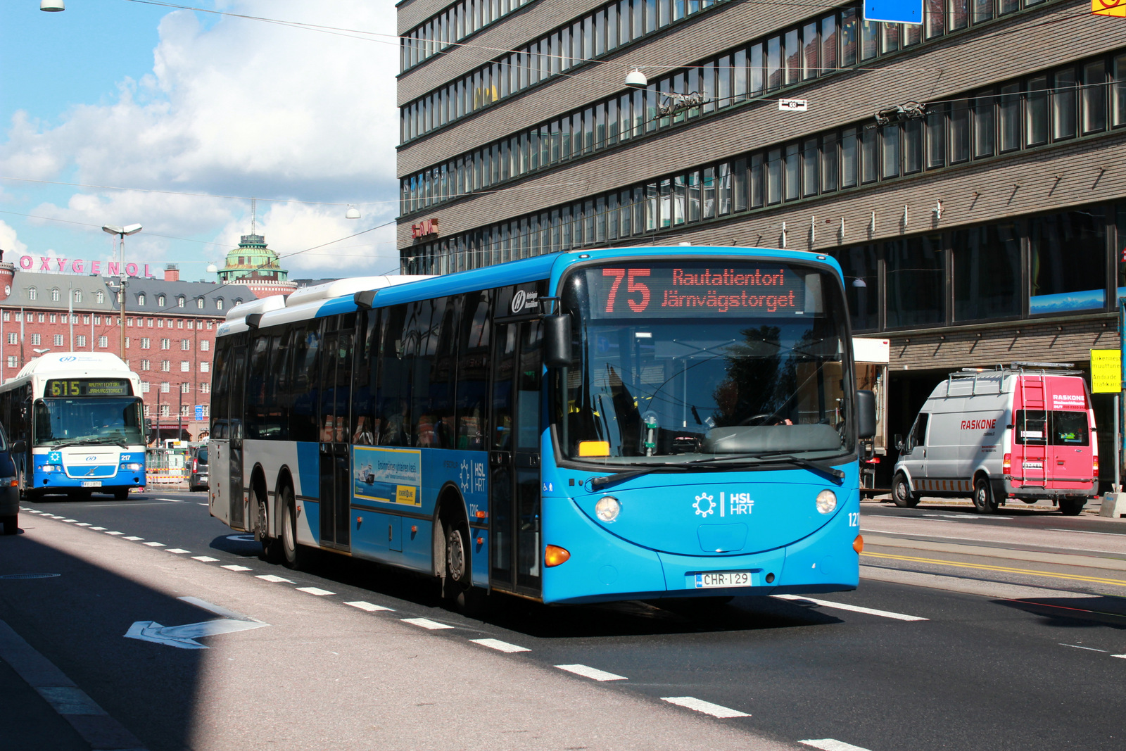

Slide 64


Slide 65


Slide 67
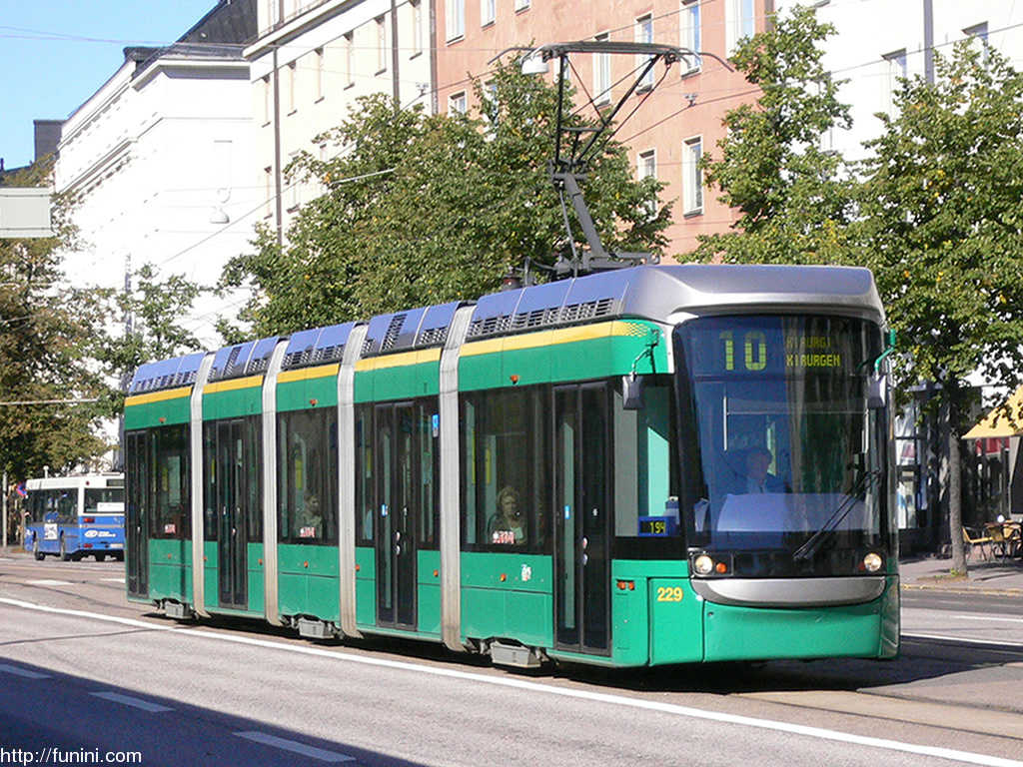

Slide 69


Slide 71
C
B
A - > C
B -> X
X = (b * C)/A
Dif = (A – B)/2
A
C * (1 – B/A)/2

